Slide 1


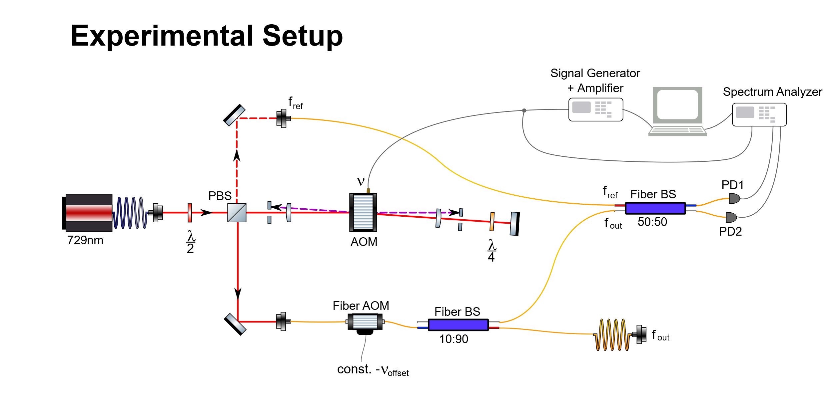
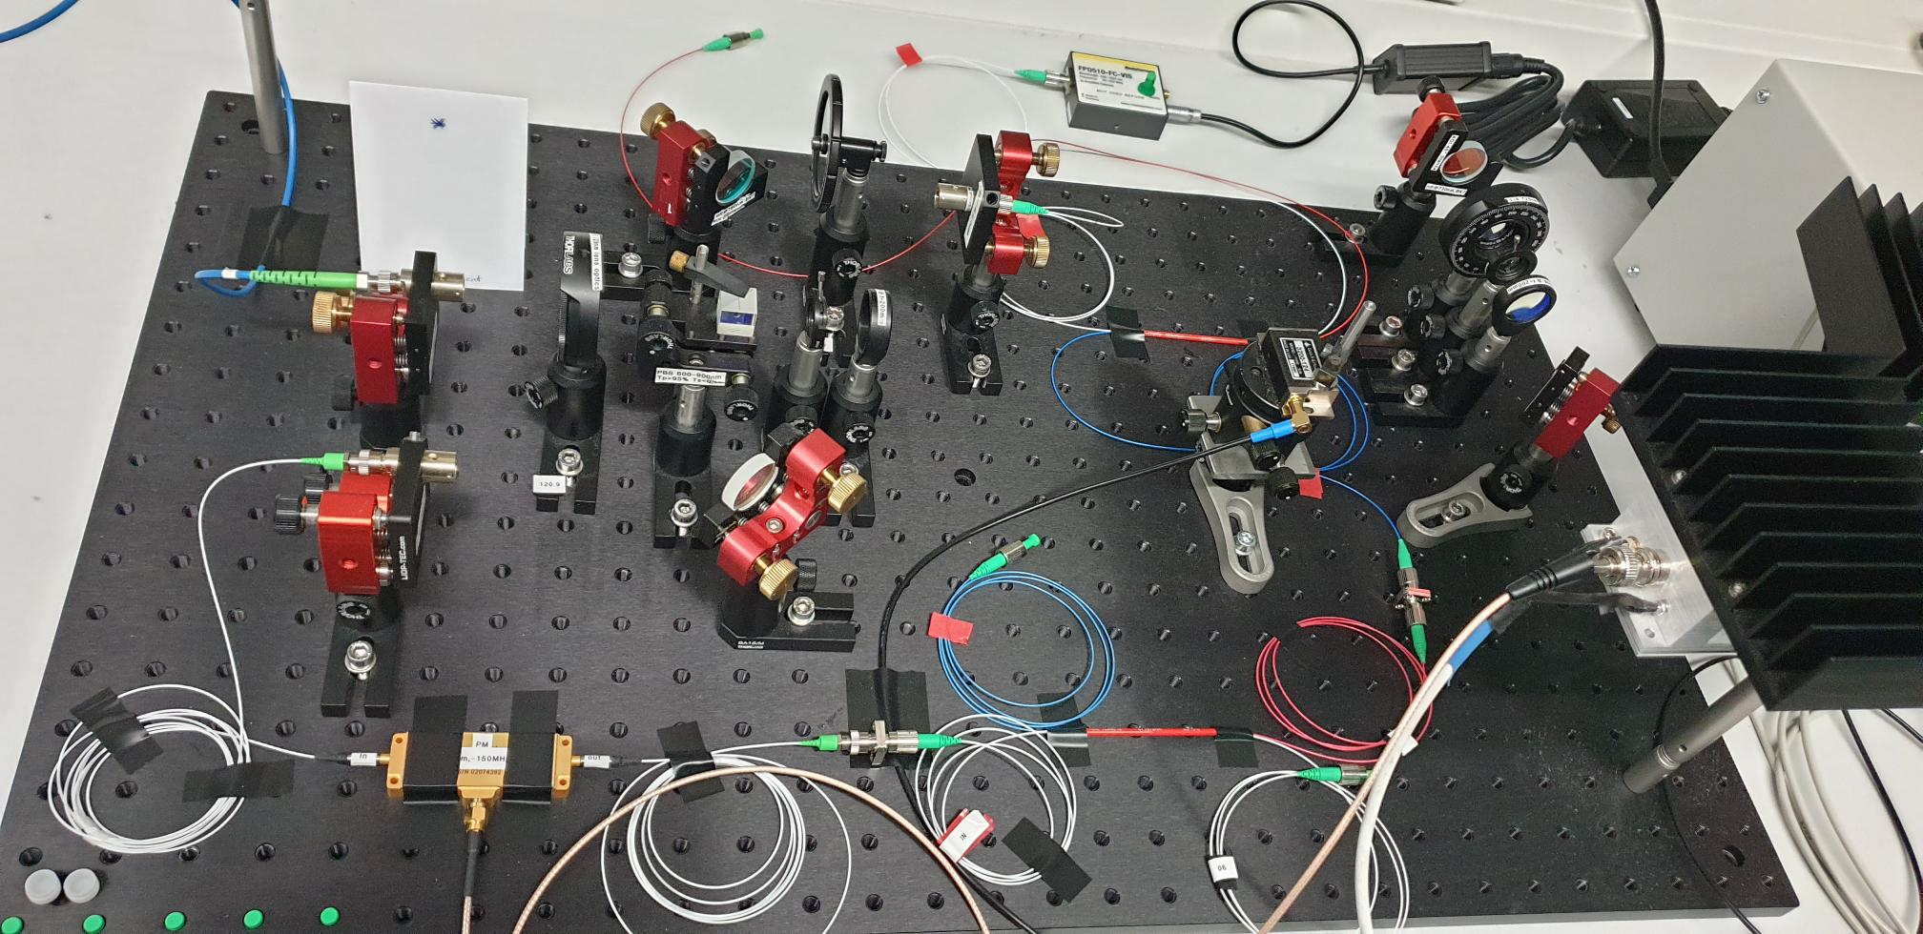
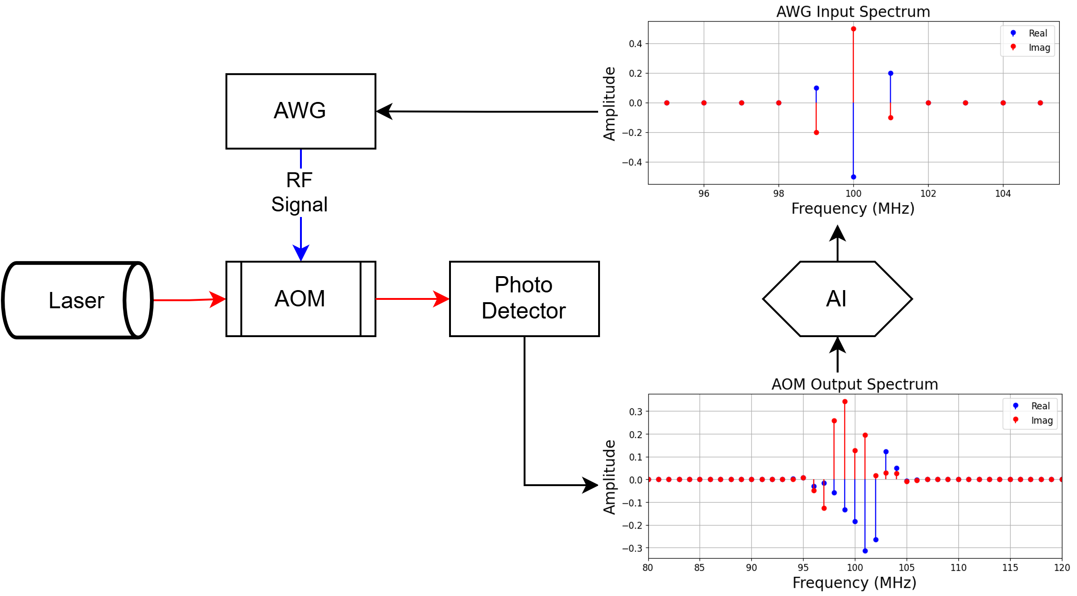
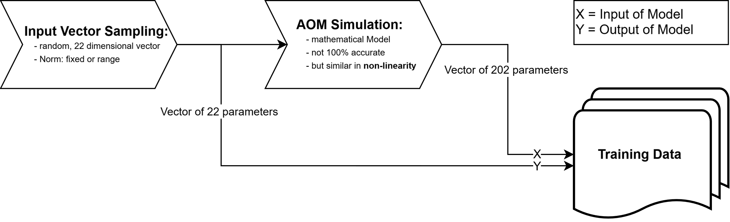
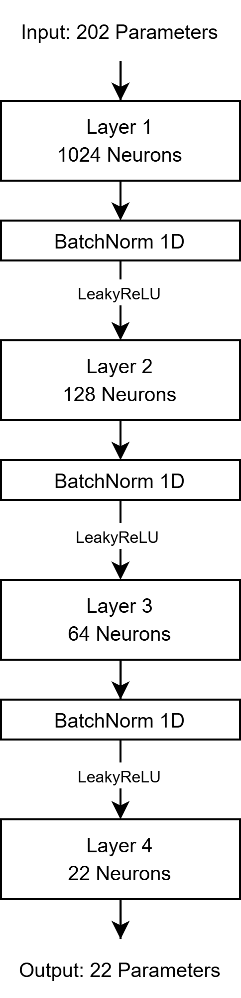
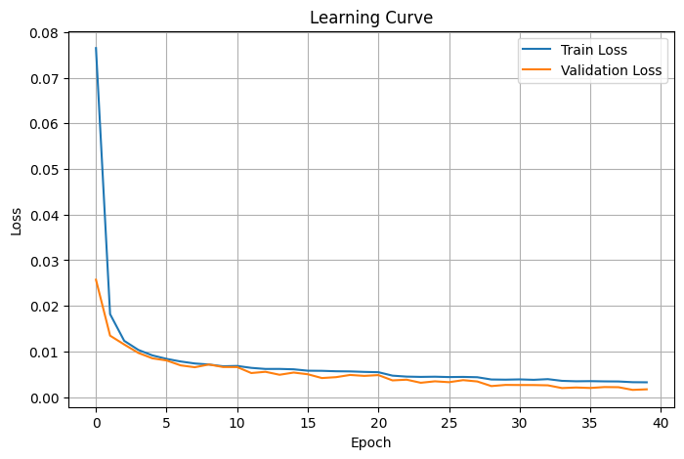
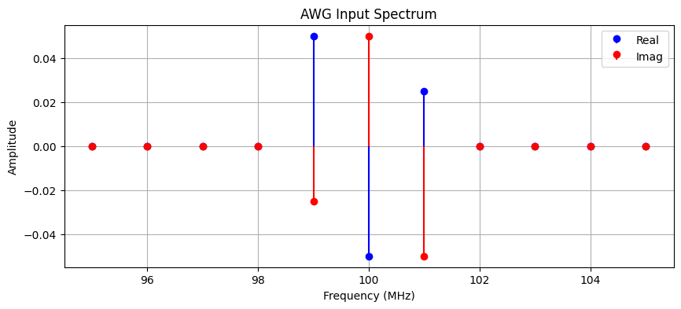
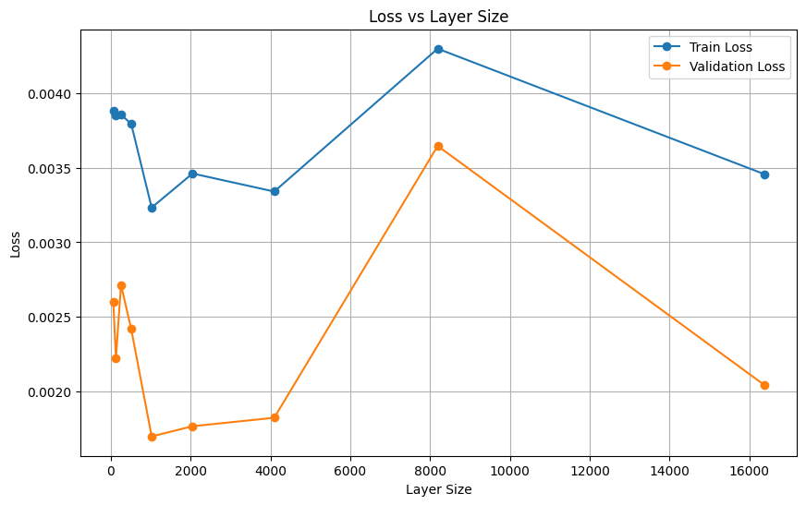
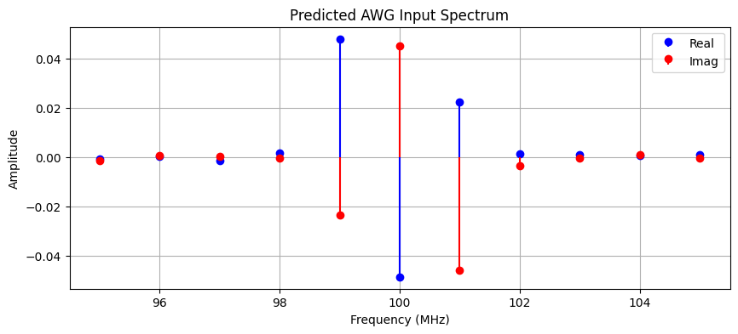
Project Seminar Data Science and Artificial Intelligence
Intelligent AOM
Project Donor: Prof. Dr. Eschner & Team (Experimental Physics – Quantum Photonics)
Leo Forster & Jonas Henker
Introduction
In the experimental setup the spectrum of an incoming laser beam is changed in an acousto-optical modulator (AOM) by interfering with an applied radio frequency (rf) signal coming from an arbitrary wave generator (AWG).
We want to predict the required frequency spectrum produced by the AWG given a desired output spectrum which should then be produced by the AOM.
Laser
AOM
Image 1: Experimental Setup
Motivation [Image 1, Image 2]
For experiments in the field of quantum photonics concrete laser frequency spectra are often needed. Due to the nonlinear and complex relationship between the input and output spectra of the AOM, the required AWG configurations can not be computed easily.
But by applying machine learning methods we can predict them to a certain accuracy. Doing so, we achieve the ability to control output frequency spectra freely, provided by the configurations given by our model.
Objectives
Find a suitable model able to predict the required AWG input spectra, given the desired AOM output spectra and observe the impact of different hyperparameters, changes in the simulation & non-linearity on the model performance.
Data Processing [Image 3]
Each AWG input spectrum has 11 complex valued Fourier coefficients (22 real valued parameters) at 11 frequencies ranging from 95 to 105 MHz.
Similar, each AOM output spectrum has 101 complex valued Fourier coefficients (202 real valued parameters) at 101 frequencies ranging from 50 to 150 MHz.
The training data is generated without noise and missing values. For this we sample the potential AWG input spectra by randomly selecting points on the surface of a 22-dimensional sphere, ensuring that the norm is constant.
The AOM output is obtained by simulating the AOM using a provided mathematical model which is physically motivated and similar in complexity.
The training data now consists of both the simulated AOM output spectra as input for the model and the sampled AWG input spectra as desired output of the model.
We train the model, utilizing the mean absolute error (MAE) as the loss function and by gradually reducing the learning rate.
Simplified Experimental Setup
Image 2
Visualization of Data Processing
Image 3
Model Architecture
Results
Image 4: Learning curve of a successful training run
Image 5: Impact of the layer size on the model performance
Image 6: Successful prediction of the model

